Slide 1

Application Layer

Slide 2
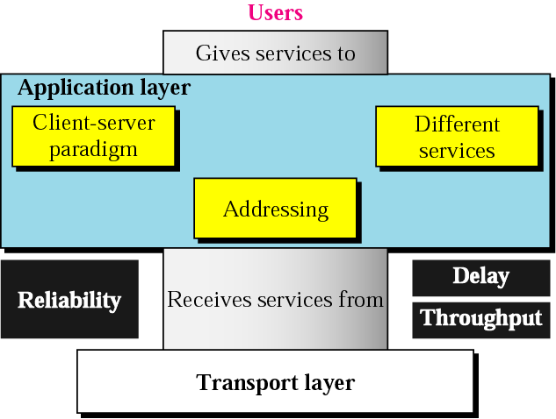
Position of Application Layer

Slide 3
Role of Application Layer
Enables the user, whether human or software, to access the network
Provides user interfaces and support for services such as electronic mail, remote file access and transfer, and access to the World Wide Web

Slide 4
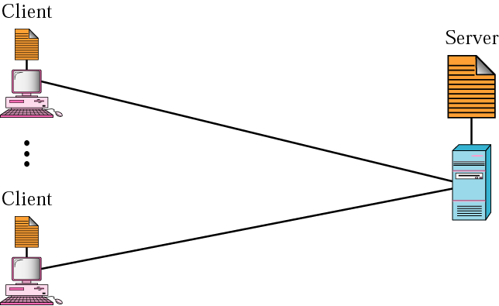
General Issues of Application Layer
Client-server Paradigm

Slide 5
General Issues of Application Layer
Addressing
  Email address
  address to access a web page
Types of Service
  Application layer is designed to give different services to the user or user programs.
    SMTP
    FTP
    WWW
    HTTP

Slide 6
Chapter 27
WWW and HTTP

Slide 7
27.1 ARCHITECTURE
The WWW today is a distributed client/server service, in which a client using a browser can access a service using a server. However, the service provided is distributed over many locations called sites.
Topics discussed in this section:
Client (Browser)
Server
Uniform Resource Locator
Cookies

Slide 8

ARCHITECTURE
The WWW today is a distributed client/server service, in which a client using a browser can access a service using a server.
The service provided is distributed over many locations called sites.

Slide 9
ARCHITECTURE
Web page
  Each site holds one or more documents, refer to as Web pages.
  Each web page can contain a link to other pages in the same site or at other sites.
  The page can be retrieved and viewed by using browsers.

Slide 10
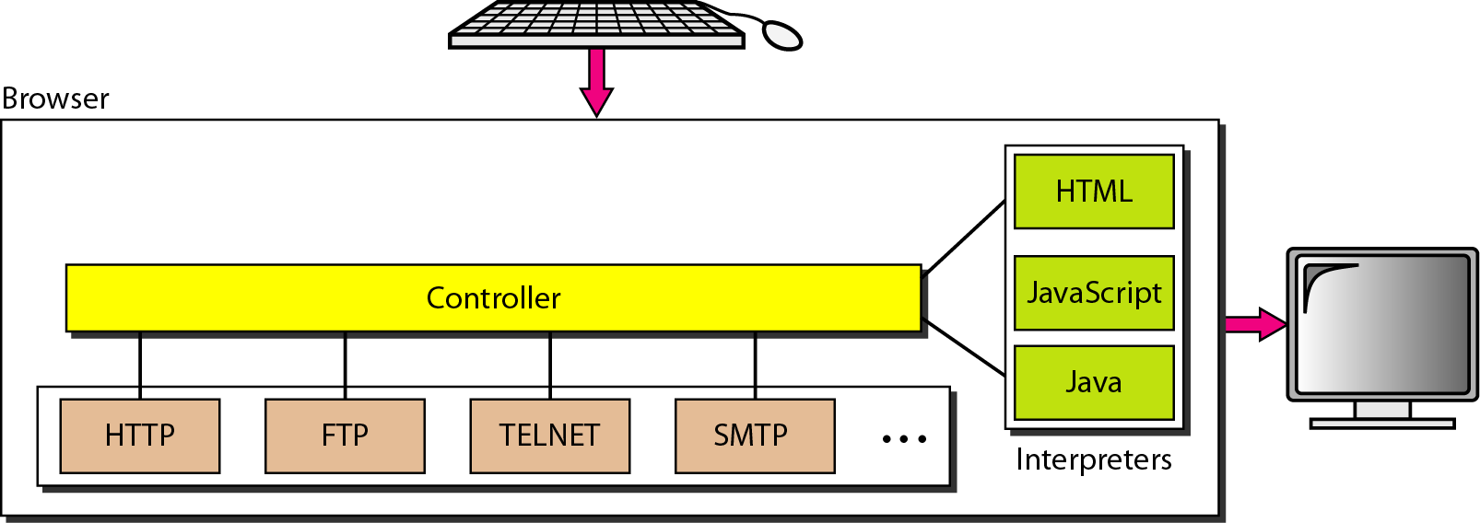
ARCHITECTURE
Client (Browser)
  Browsers interpret and display a Web document.
  Each browser usually consists of three parts.
    The controller receives input from the key board or the mouse.
    - After the document has been accessed, the controller uses one of the interpreters to display the document on the screen.
    The client protocol can be one of the protocols such as HTTP.
    The interpreter can be HTML, JAVA, or JavaScript, depending on the type of document.

Slide 11
ARCHITECTURE
Server
  The Web page is stored at the server.
  Each time a client request arrives, the corresponding document is sent to the client.
  To improve efficiency, servers normally store requested files in a cache in memory.
  A server can also become more efficient through multithreading or multiprocessing.
    A server can answer more than one request at a time.

Slide 12
ARCHITECTURE
Uniform Resource Locator
  A client that wants to access a Web page needs the address.
  To facilitate the access of documents distributed through the world, HTTP uses locators.
  The Uniform Resource Locator (URL) is a standard for specifying any kind of information on the Internet.
  The URL defines 4 things: protocol, host computer, port, and path.
http://networking.khu.ac.kr:80/courses/cour.htm

Slide 13
ARCHITECTURE
Uniform Resource Locator (cont’d)
  PROTOCOL : The client/server program used to retrieve the document. The most common today is HTTP.
    http, ftp, and so on.
  HOST : The computer on which the information is locate, although the name of the computer can be an alias.
    Computers are given alias names that usually begin to the computers “WWW”.
  PORT : The URL can optionally contain the port No. of the server.
    If the port is included, it is inserted between the host and the path, and separate from the host by a colon.
  PATH : The path name of the file where the information is located.

Slide 14
ARCHITECTURE
Cookies
  Information the server has gathered about the client such as name, registration number, and so on.
  Creation and storage of Cookies
    When a server receives a request from a client, it stores information about the client in a file or a string.
    The information may include the domain name of the client, the contents of the cookie, timestamp, and other information depending on the implementation.
    The server includes the cookies in the response that it sends to the client.
    When the client receives the response, the browser stores the cookies in the cookie directory, which is sorted by the server name.

Slide 15
27-2 WEB DOCUMENTS
The documents in the WWW can be grouped into three broad categories: static, dynamic, and active. The category is based on the time at which the contents of the document are determined.
Topics discussed in this section:
Static Documents
Dynamic Documents
Active Documents

Slide 16
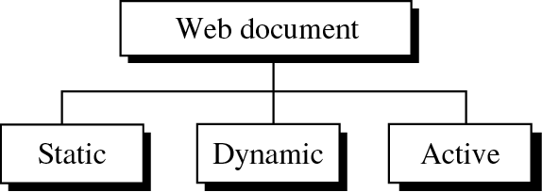
WEB DOCUMENTS
Categories of Web documents

Slide 17
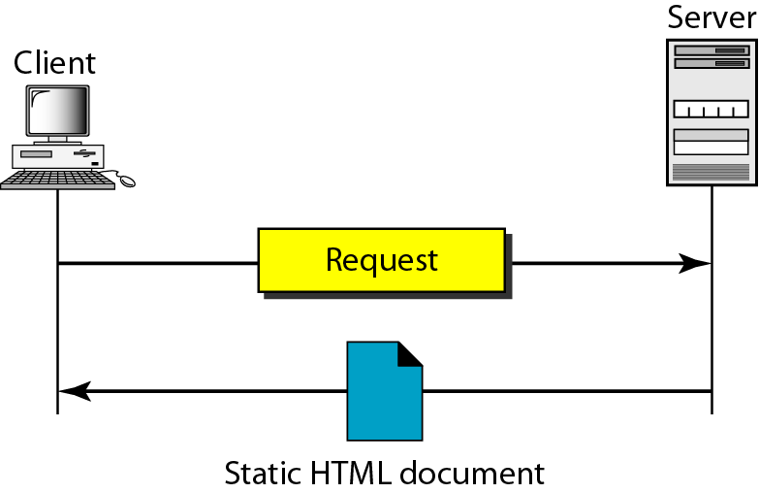
Static Documents
Static documents are fixed-content documents that are created and stored in a server.
The client can get only a copy of the document.
The contents of the file are determined when the file is created, not when it is used.
Of course, the contents in the server can be changed, but the user cannot change them.
The user can then use a browsing program to display the document.

Slide 18
HTML (Hypertext Markup Language)
HTML is a language for creating Web pages
The term markup language comes from the book publishing industry.
A markup language allows us to embed formatting instructions in the file itself.
  The instructions are included with the text.
  In this way, any browser can read the instructions and format the text according to the specific workstation.

Slide 19
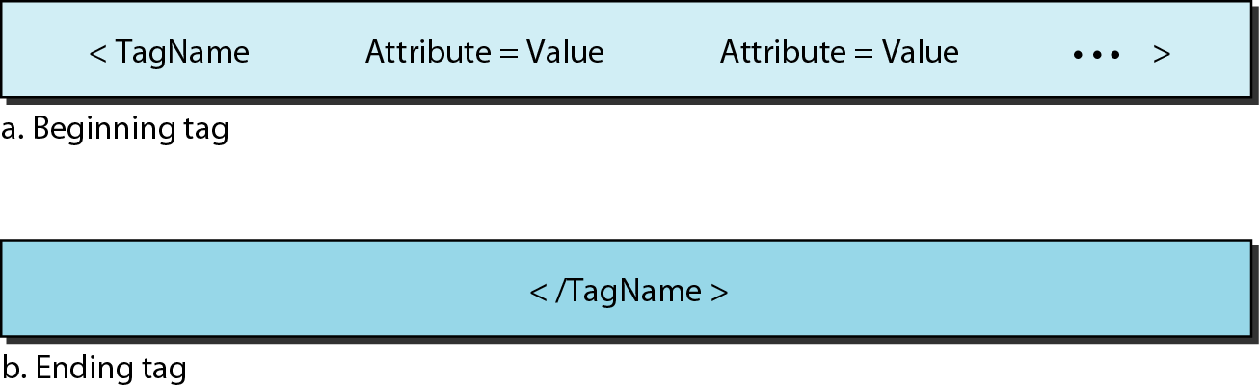
HTML (Hypertext Markup Language)
The Web page is made of two parts : the head and the body
  Head : contains the title of the page and other parameters that the browser will use.
  Body : includes the text (actual information in a page) and the tag.
  Tag : define the appearance of the document.

Slide 20
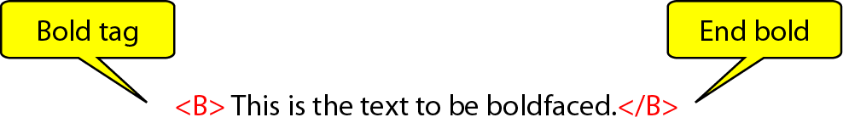
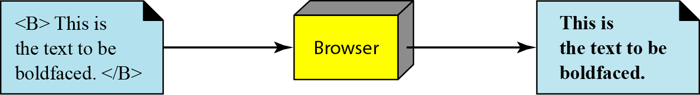
HTML (Hypertext Markup Language)
  One commonly used tag category is the text tags such as
<B> and </B>; <I> and </I>; and <U> and </U>
Bold Tag
  We put beginning and ending boldface tags (marks) in the text.
Figure 27.5 Boldface tags
Figure 27.6 Effect of boldface tags

Slide 21
HTML
Common tags
Beginning Tag | Ending Tag | Meaning
Skeletal Tags
<HTML> | </HTML> | Defines an HTML document
<HEAD> | </HEAD> | Defines the head of the document
<BODY> | </BODY> | Defines the body of the document
Title and Header Tags
<TITLE> | </TITLE> | Defines the title of the document
<Hn> | </Hn> | Defines the title of the document

Slide 22
HTML
Common tags
Beginning Tag | Ending Tag | Meaning
Text Formatting Tags
<B> | </B> |  | Boldface
<I> | </I> |  | Italic
<U> | </U> |  | Underlined
<SUB> | </SUB> |  | Subscript
<SUP> | </SUP> |  | Superscript
Data Flow Tag
<CENTER> | </CENTER> |  | Centered
<BR> | </BR> |  | Line break

Slide 23
HTML
Beginning Tag | Ending Tag | Meaning
List Tags
<OL> | </OL> |  | Ordered list
<UL> | </UL> |  | Unordered list
<LI> | </LI> |  | An item in a list
Image Tag
<IMG> |  |  | Defines an image
Hyperlink Tag
<A> | </A> |  | Defines an address (hyperlink)
Executable Contents
<APPLET> | </APPLET> |  | The document is an applet

Slide 24
HTML (Hypertext Markup Language)
Image Tag
  Another interesting tag category is the image tag.
  Nontextual information such as digitized photos or images is not a physical part of an HTML document.
  But we can use an image tag to point to the file of a photo or image.
<IMAG SRC=“/bin/images/image1.gif”ALIGN=MIDDLE>

Slide 25
HTML (Hypertext Markup Language)
Hyperlink Tag
  A third interesting category is the hyperlink tag, which is needed to link documents together.
  Any item (word, phrase, or image) can refer to another document through a mechanism called an anchor.
  The anchor is defined by <A…> and </A> tags, and displayed, the anchored item is underlined, blinking, or boldfaced.
  The user can click on the anchored item to go to another document.
<A HREF= “http://www.deanza.edu/forouzan”>Author</A>

Slide 26
Dynamic Documents
Dynamic document
  Dynamic documents do not exist in a predefined format.
  Dynamic document is created by a Web server whenever a browser requests the document.
    Because a fresh document is created for each request, the contents of a dynamic document can vary from one request to another.
  Ex) The retrieval of the time and date from a server.
  Time and date are kinds of information that are dynamic in that they change from moment to moment.
  The server sends the result of the program to the client (browser).

Slide 27
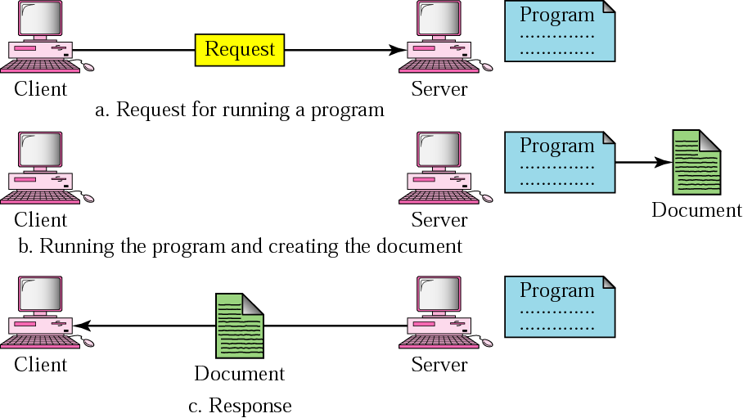
Dynamic Documents
Dynamic document
  does not exist in a predefined format.
  is created by a Web server whenever a browser requests the document.

Slide 28
CGI (Common Gateway Interface)
A technology that creates and handles dynamic document.
  CGI is a set of standards that defines
    how a dynamic document is written
    How data are input to the program
    And how the output result is used.
  CGI is not a new language;
    instead, it allows programmers to use any of several languages such as C, C++, Bourne Shell, C shell or Perl.
    The only thing that CGI defines is a set of rules and terms that the programmer must follow.

Slide 29
CGI (Common Gateway Interface)
CGI
  Common : defines a set of rules that is common to any language or platform.
  Gateway : A CGI program can be used to access other resources such as database, graphical package and so on.
  Interface : There is a set of predefined terms, variables, calls and so on, that can be used in any CGI program.

Slide 30
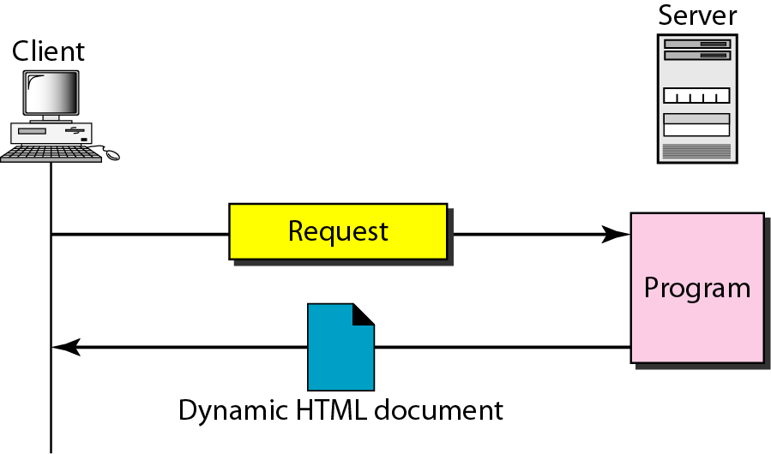
CGI (Common Gateway Interface)
Figure 27.8 Dynamic document using CGI
http://www.deanzan/cgi-bin/prog.pl?123

Slide 31
Scripting Technologies
Scripting Technologies for Dynamic Document
  The problem with CGI technology is the inefficiency that results if part of the dynamic document that is to be created is fixed and not changing from request to request.
  The solution is to create a file containing the fixed part of the document using HTML and embed a script, a source code, that can be run by the server to provide the varying section.
    A few technologies have been involved in creating dynamic documents using scripts.
    Among the most common are Hypertext Preprocessor (PHP); Java Server Pages (JSP); Active Server Pages (ASP) and ColdFusion.

Slide 32
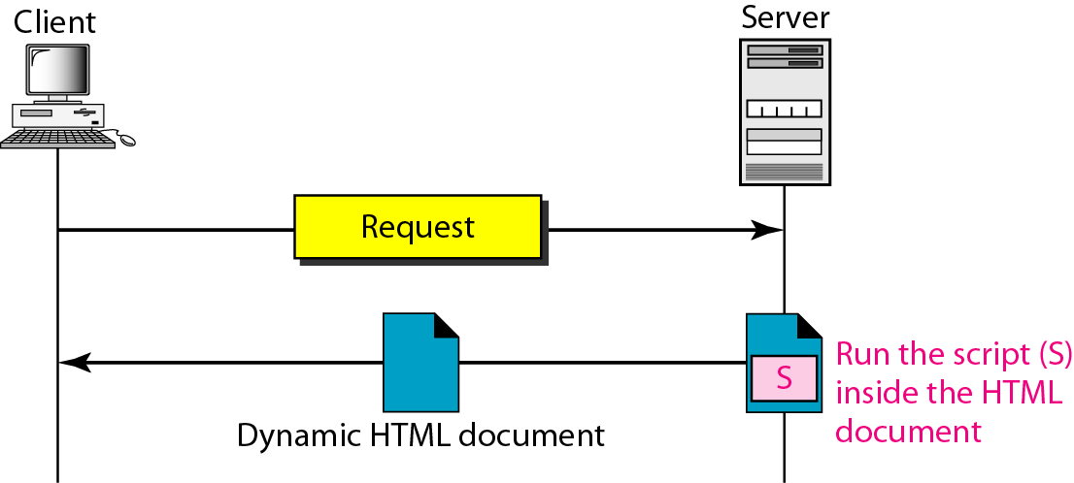
Scripting Technologies
Figure 27.9 Dynamic document using server-site script
Dynamic documents are sometimes referred to as server-site dynamic documents.

Slide 33
Active Documents
Active document
  A program or a script to be run at the client site are called Active document.
  The program definitely needs to be run at the client site where the animation or interaction takes place.
  Ex) want to run a program that creates animation graphics on the screen or a program that interacts with the user.
  When a browser requests an active document, the server sends a copy of the document or a script.
  The document is then run at the client (browser) site.

Slide 34
Active Documents
Java Applets
  One way to create an active document is to use Java applets.
  Java is a combination of a high-level programming language, a run-time environment, and a class library that allows a programmer to write an active document (an applet) and a browser to run it.
  It can also be a stand-alone program that doesn’t use a browser.
  An applet is a program written in Java on the server.

Slide 35
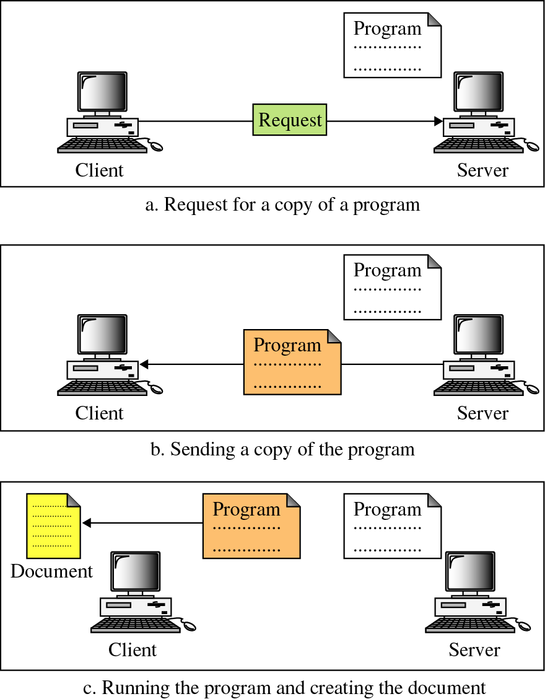
Active Documents
compiled binary code
sending binary code in compressed form
execution of binary code using user’s application S/W
Applet

Slide 36
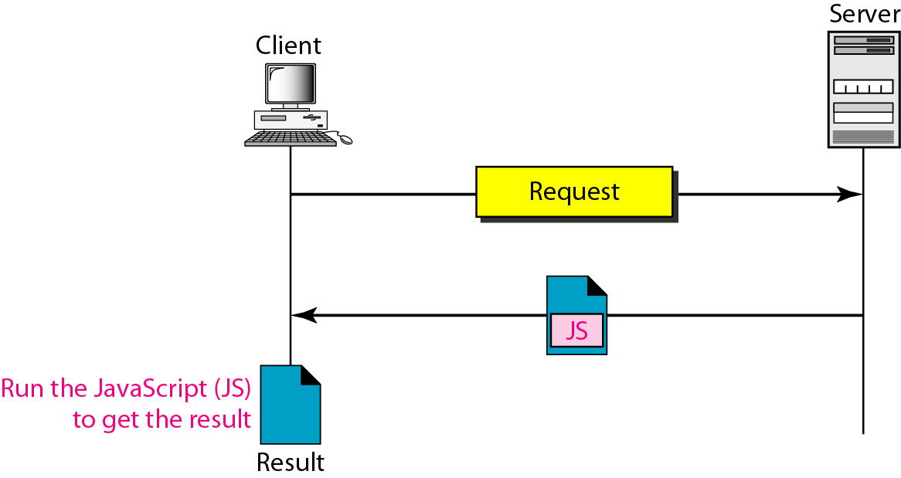
Active Documents
Active Documents
Figure 27.11 Active document using client-site script
Active documents are sometimes referred to as client-site dynamic documents.

Slide 37
Active Documents
Java Script
  The idea of scripts in the dynamic documents can also be used for active documents.
  If active part of the document is small, it can be written in a scripting language; then it can be interpreted and run by the client at the same time.
  The script is in source code (text) and not in binary form.
  The scripting technology used in this case is usually JavaScript.
  JavaScript, which bears a small resemblance to Java, is a very high level scripting language developed for this purpose.

Slide 38
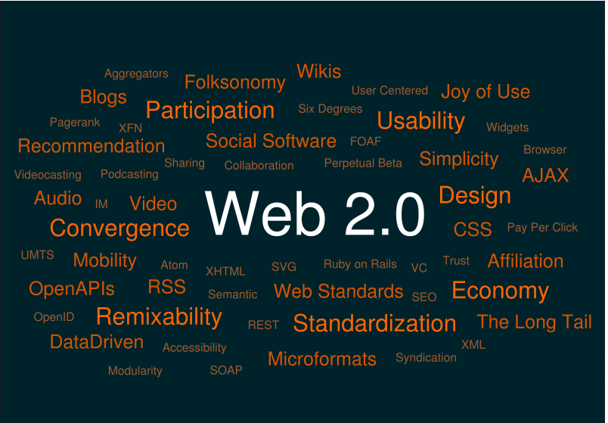
Web 2.0
Web 2.0 is a term describing the trend in the use of World Wide Web technology and web design that aims to enhance creativity, information sharing, and, most notably, collaboration among users.

Slide 39

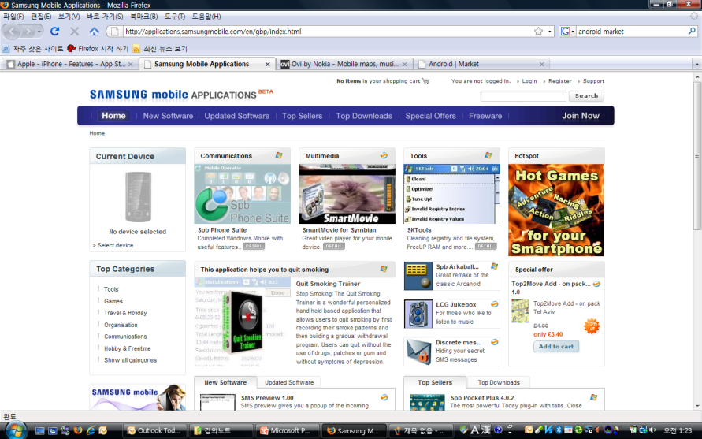

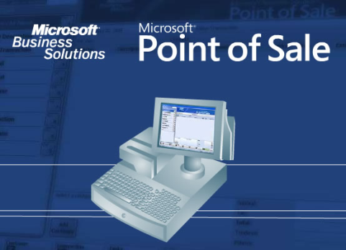

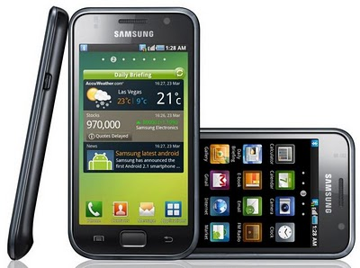
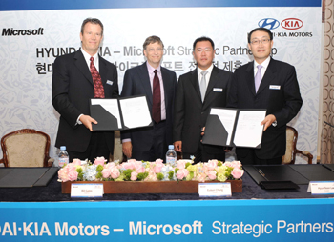
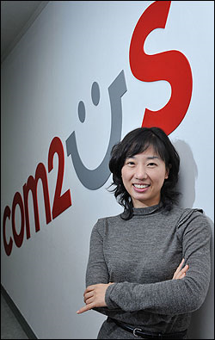
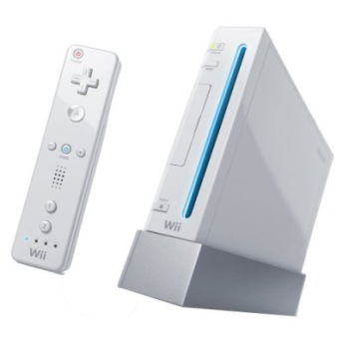
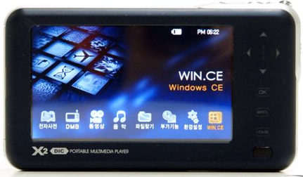
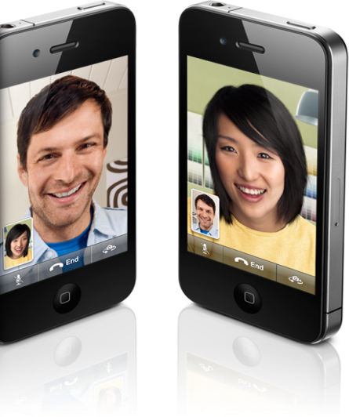
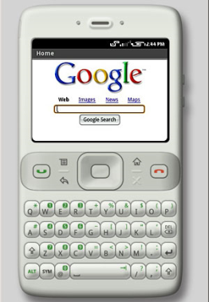
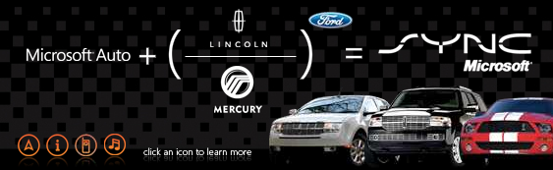
Convergence and Smart Phone

Slide 40
Summary
Application layer is responsible for providing services to the user
The www is a repository of information linked together from points all over the world
A browser consists of a controller, client programs, and interpreter
A Web document can be classified as static, dynamic, or active
HTML is a language used to create static Web pages
CGI is a standard for creating and handling dynamic Web documents
CGI program with its embedded CGI interface tags can be written in a language such as C, C++, Shell Scripts, or Perl
HTTP is the main protocol used to access data on WWW
HTTP uses a TCP connection to transfer files

Slide 41

Thank you !!

